Slide 1
News Classification Using NLP
Presented by-
Kinchal Sharma Tandon
Shruti Dhruv
Sneha Lokare
Tushardeep Singh

Slide 2
Problem Statement
Internet is nowadays flooded with many daily News. It is crucial that the News is classified to allow users to access information of their interest.
To manually Classify large number of articles is time consuming and less accurate.
Hence the idea of Automatic News Classification.

Slide 3
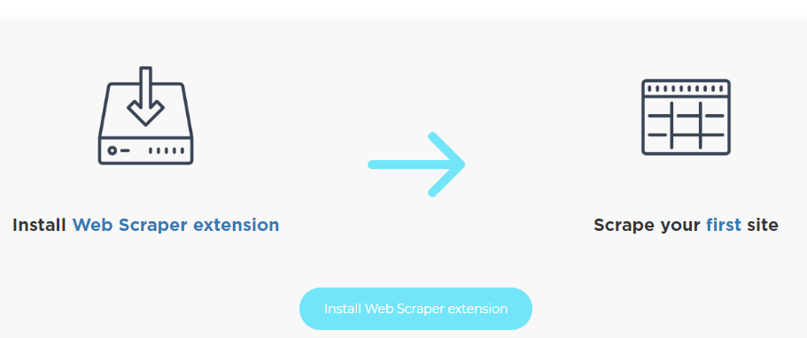
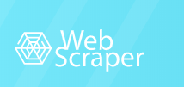


News Collection
Websites Scraped

Slide 4
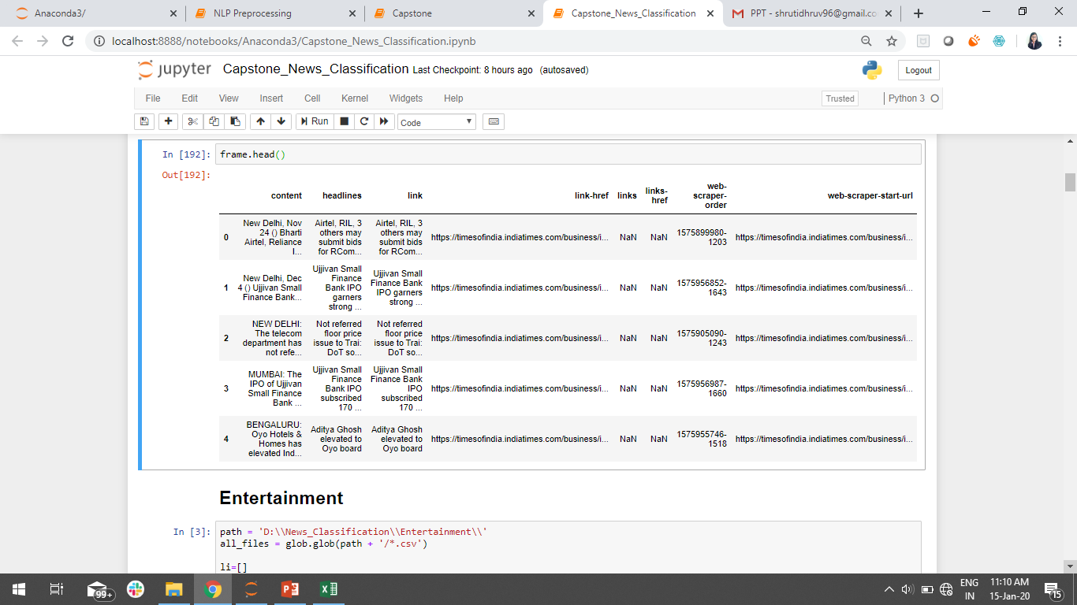
Sample

Slide 5
About the Data
Size-42k+ Articles
Categories
Sports, Business, Tech, Entertainment
Corpus size-12M + words

Slide 6
EDA

Slide 7
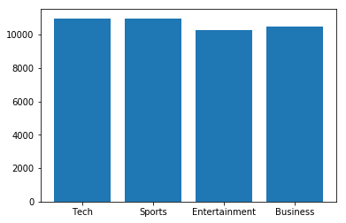
Category-wise Distribution

Slide 8
Unigrams and Bigrams

Slide 9
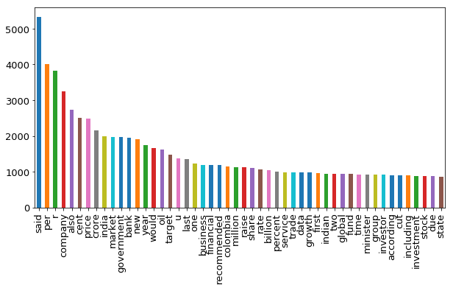
Business Top 50 words
We infer that words like company, Rs, price, business, market are prominent in our business corpus

Slide 10
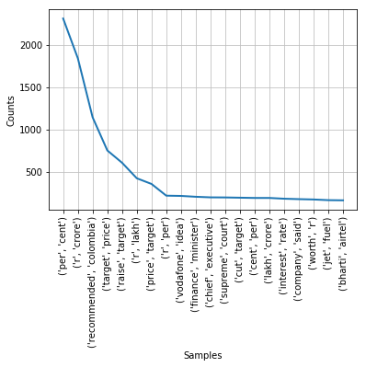
Top 20 Bigrams

Slide 11
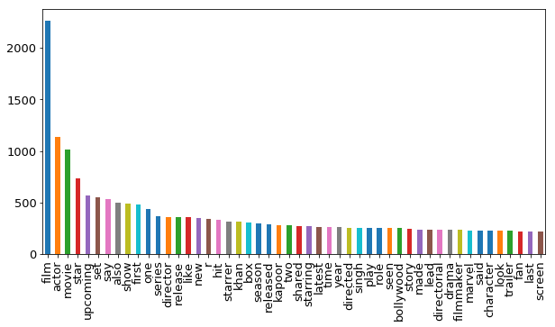
Entertainment Top 50 words

Slide 12
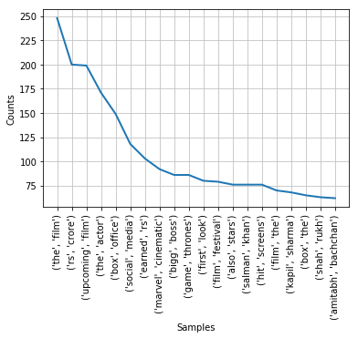
Top 20 Bigrams

Slide 13
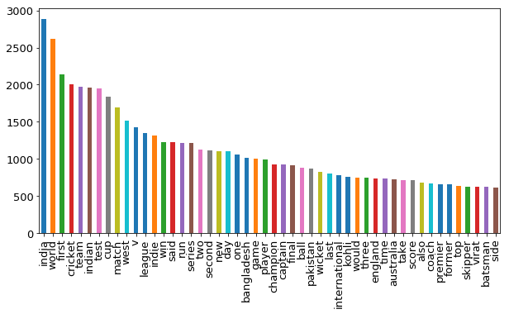
Sports Top 50 words

Slide 14
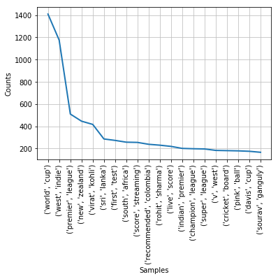
Top 20 Bigrams

Slide 15
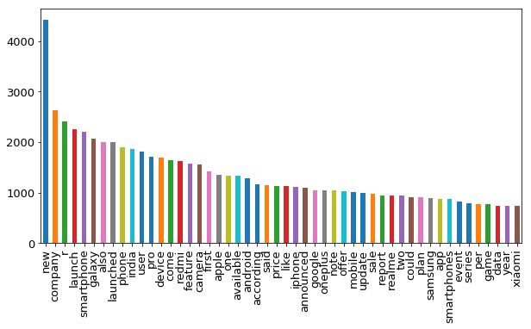
Tech Top 50 words

Slide 16
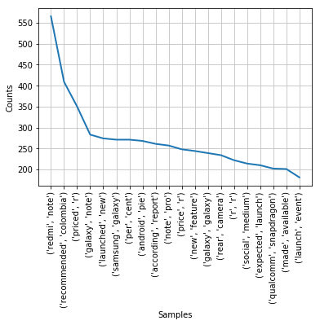
Top 20 Bigrams

Slide 17
Classification Model
Training
Dataset
Input News
Feature Extraction
Ml Model
Test News
Trained Model
Label
Test Dataset

Slide 18
Classification Report
using content

Slide 19
Models | Accuracy | Precision | Recall | F1-Score
Multinomial Naïve Bayes using Count Vectorizor | Test acc-0.94 Train acc-0.96 | Tech-0.95 Sports-0.97 Ent-0.96 Business-0.91 | Tech-0.98 Sports-0.98 Ent-0.89 Business-0.96 | Tech-0.96 Sports-0.97 Ent-0.92 Business-0.94
Support Vector Machine using Count Vectorizor | Test acc-0.95 Train acc-0.99 | Tech-0.95 Sports-0.97 Ent-0.96 Business-0.91 | Tech-0.98 Sports-0.98 Ent-0.89 Business-0.96 | Tech-0.96 Sports-0.97 Ent-0.92 Business-0.94
Multinomial Naïve Bayes using TF-IDF | Test acc-0.95 Train acc-0.96 | Tech-0.97 Sports-0.97 Ent-0.95 Business-0.93 | Tech-0.96 Sports-0.98 Ent-0.92 Business-0.96 | Tech-0.97 Sports-0.97 Ent-0.94 Business-0.95
Support Vector Machine using TF-IDF | Test acc-0.96 Train acc-0.99 | Tech-0.96 Sports-0.98 Ent-0.95 Business-0.97 | Tech-0.98 Sports-0.98 Ent-0.95 Business-0.96 | Tech-0.97 Sports-0.98 Ent-0.95 Business-0.96

Slide 20
Comparing Both the Models
Model Performance | Model Accuracy
By using Count Vectorizer, Both Naïve Bayes and SVM perform in same way. | SVM has better accuracy than Naïve Bayes both in terms of train and test.
By using TF-IDF SVM out performs Naïve Bayes | SVM has better train and test accuracy than Naïve Bayes

Slide 21
Classification Report
using Headlines

Slide 22
Models | Accuracy | Precision | Recall | F1-Score
Multinomial Naïve Bayes using Count Vectorizor | Test acc-0.94 Train acc-0.96 | Tech-0.97 Sports-0.96 Ent-0.92 Business-0.93 | Tech-0.94 Sports-0.97 Ent-0.94 Business-0.93 | Tech-0.95 Sports-0.96 Ent-0.93 Business-0.93
Support Vector Machine using Count Vectorizor | Test acc-0.94 Train acc-0.99 | Tech-0.97 Sports-0.96 Ent-0.92 Business-0.93 | Tech-0.94 Sports-0.97 Ent-0.94 Business-0.93 | Tech-0.95 Sports-0.96 Ent-0.93 Business-0.93
Multinomial Naïve Bayes using TF-IDF | Test acc-0.94 Train acc-0.96 | Tech-0.98 Sports-0.95 Ent-0.92 Business-0.94 | Tech-0.93 Sports-0.98 Ent-0.94 Business-0.92 | Tech-0.95 Sports-0.96 Ent-0.93 Business-0.93
Support Vector Machine using TF-IDF | Test acc-0.95 Train acc-0.98 | Tech-0.94 Sports-0.98 Ent-0.96 Business-0.94 | Tech-0.96 Sports-0.98 Ent-0.94 Business-0.94 | Tech-0.95 Sports-0.98 Ent-0.95 Business-0.94

Slide 23
Comparing Both the Models
Got the same result as obtained while using Content

Slide 24
Using Topic Modelling LDA (Latent Dirichlet Allocation)

Slide 25
The Idea behind LDA
Unsupervised Learning Algorithm
Can read through the text documents and automatically output the topics discussed.
It is known to run faster and gives better topics segregation.

Slide 26
How it works?
Each document as a collection of topics in a certain proportion.
Each topic as a collection of keywords, again, in a certain proportion.
Provide the algorithm with the number of topics, all it does it to rearrange the topics distribution to obtain a good composition of topic.

Slide 27
Example
Each document as a collection of topics in a certain proportion
Doc1
Topic1-50%
Topic2-20%
Doc2
Topic2-80%
Topic3-10%
Doc3
Topic2-30%
Topic4-40%

Slide 28
Each topic as a collection of keywords, again, in a certain proportion
Price
Business
Company
Market
Reliance
World cup
Match
Won
Titles
Google
Gadgets
Camera
Technology
Movie
Blockbuste
Shahrukh
Salman

Slide 29
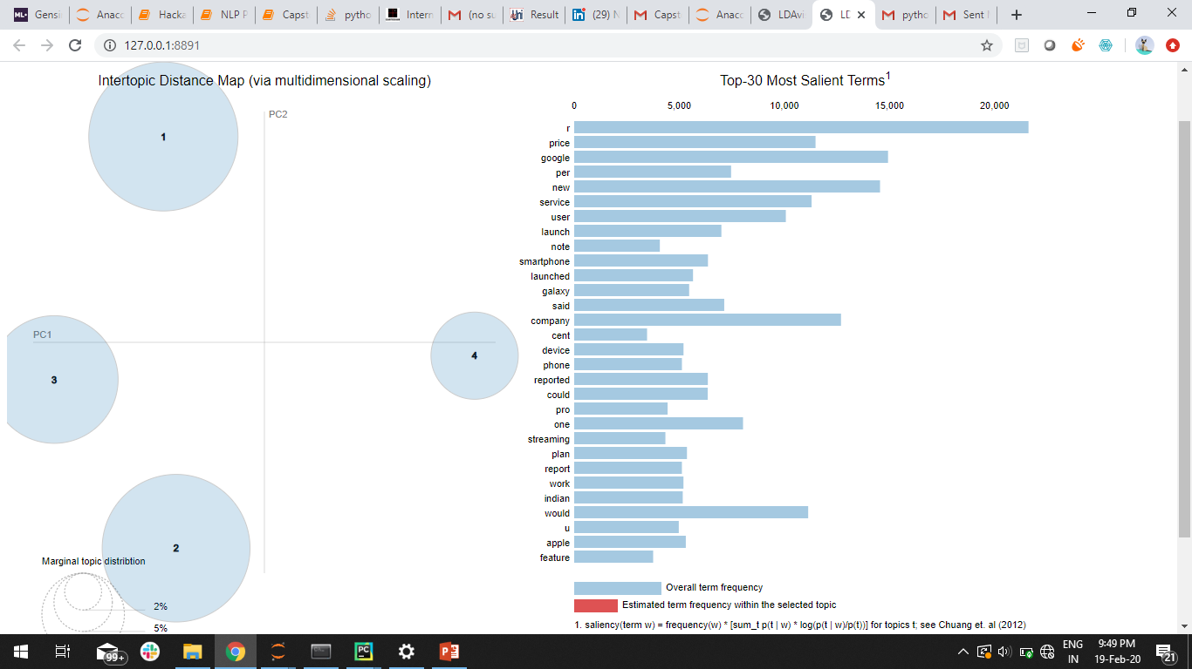

Slide 30
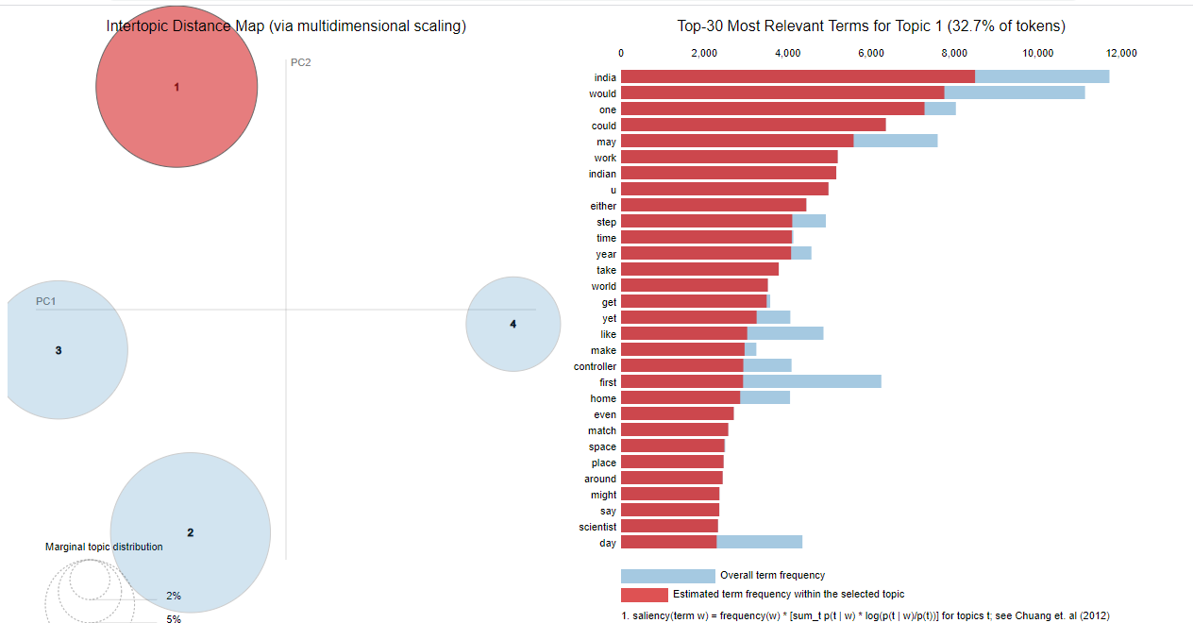

Slide 31
Conclusion
Both SVM and Naïve Bayes are good classifiers and both can be used for classification.
Using Preprocessing methods is very important in text classification, here TF-IDF is good method
LDA was able to segregate the topics well but failed to recognize Entertainment

Slide 32
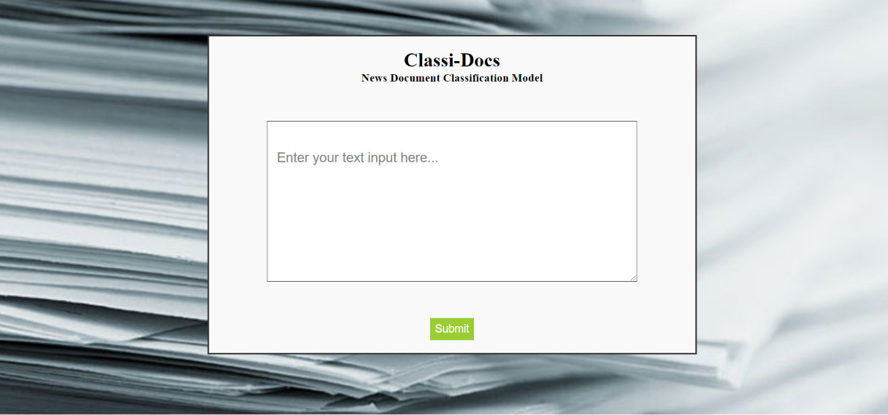
Classi-Docs (UI)

Slide 33
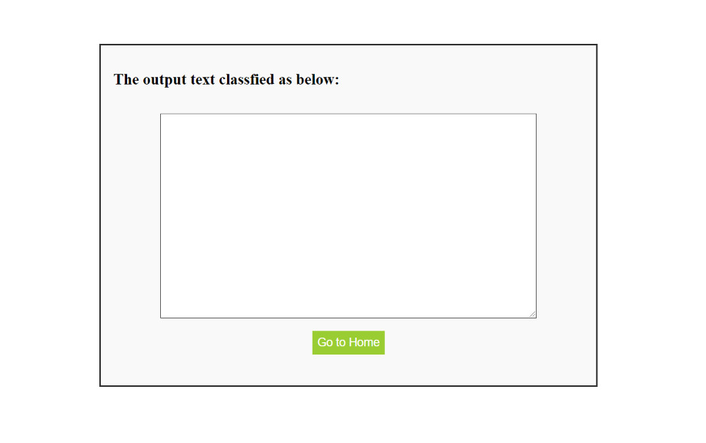
Output Screen

Slide 34
Tools Used
Web Scraper
Python
Machine Learning
NLP
HTML
Flask

Slide 35


